Slide 1
Our journey has begun
“Far from what I once was but not yet what I’m going to be”

Slide 2
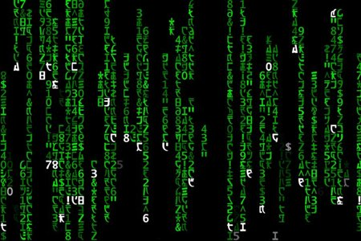
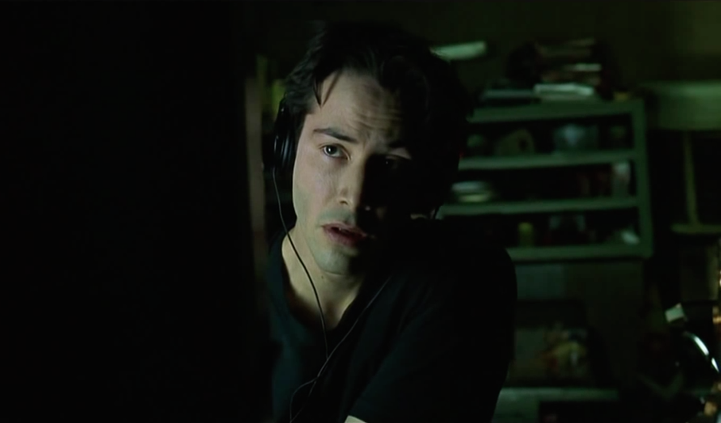
My first weekend

